Slide 1
ParkMandu
TECHNICAL PROGRESS
069-BEX
Pranish Bhagat
Pratik Bhandari
Ashish Dhamala
Dip Kamal Bhusal
Kanhaiya Lal Shrestha

Slide 2
The Problem
Company
Context
Problem statement
ParkMandu-
StartUp for Remote Parking Management
Excessive traffic in the city followed by improper management of public and private parking spaces.
The parking in the city is heavily dismantled.
People spend a lot of time and money on these parking services.

Slide 3
Challenges deep-dive
Challenge 1
Challenge 2
Challenge 3
Detect open parking space
Accurate detection of open and occupied parking space with the help of Image Processing.
Local-web-server
A simple webpage for productive front-end development.
Transmission of the information
Transmission of appropriate information to the webpage about the availability of open and occupied parking spaces

Slide 4
Front End Lead
Ashish Dhamala
Back End Lead
Pratik Bhandari
Business and Finance Lead
The Team
Pranish Bhagat
Resource Lead
Dip Kamal Bhusal
Marketing Lead
Kanhaiya Lal Shrestha

Slide 5
Implementation

Slide 6


Slide 7
Front End

Slide 8



Progress - Technical
Frontend
Web App development - CSS/HTML
Application Platform - Android
Live Video Streaming - Flask

Slide 9

HTML
HTML is a markup language for describing web documents (web pages)
In our project,
HTML is used to provide framework to the webpage
The structure of the web page is given by HTML

Slide 10

CSS
Full Form: Cascading Style Sheets (CSS)
In our project,
we have used CSS to style the webpage.
Without CSS the web page would look less attractive

Slide 11
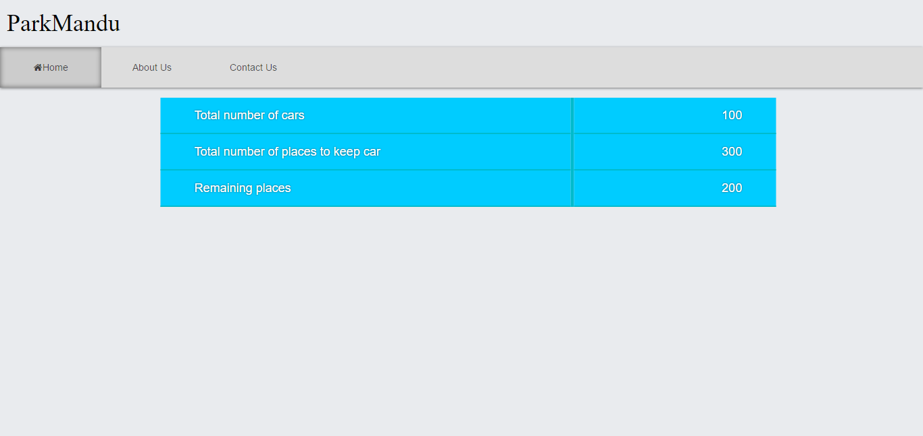
Screenshot

Slide 12
Remaining Tasks
Complete design of the web page.
Displaying the data from the database itself instead of dummy data.

Slide 13
Back End

Slide 14
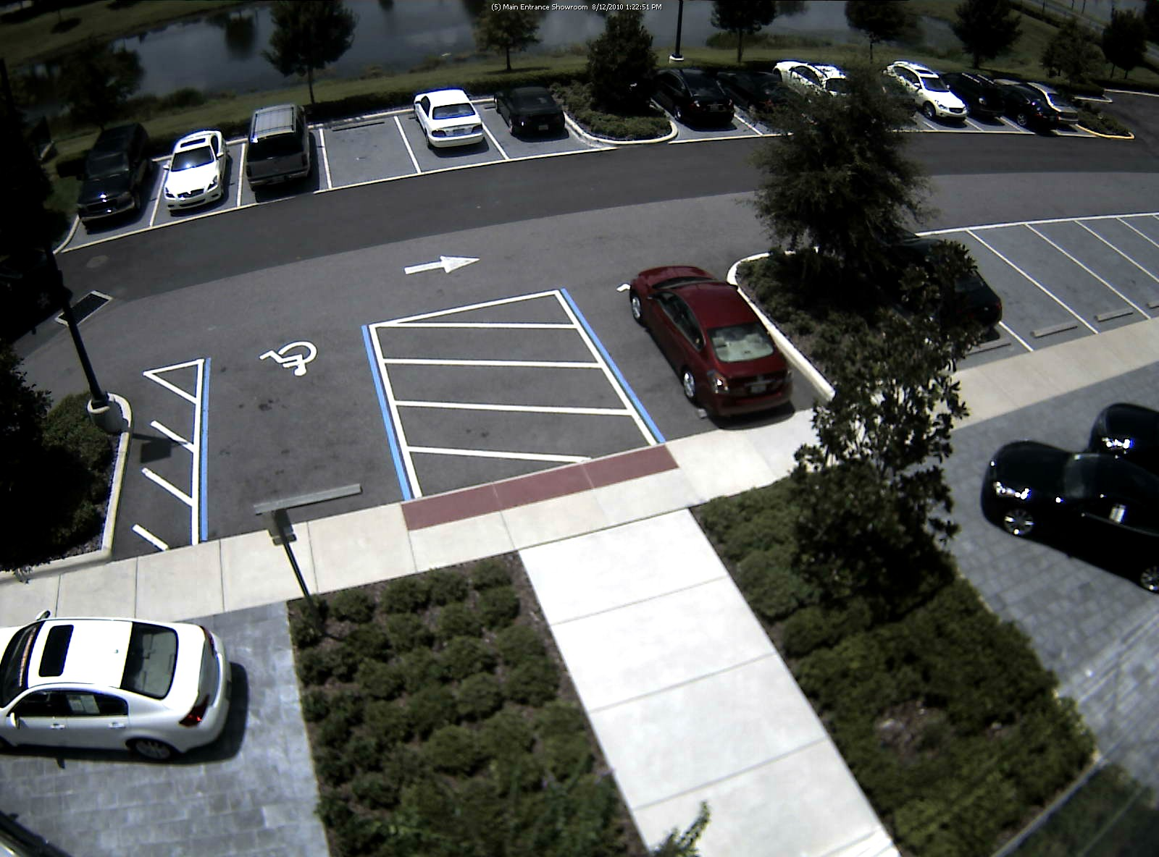
How?
Capture image from camera
With a phone in real application
With a camera in prototype demonstration
Process captured image and calibrate

Slide 15

How?
Check for presence of free or booked parking space, using fixed patterns for recognition
Transfer resulting information to web application through a remote server

Slide 16



Progress - Technical
Backend
Image Processing - OpenCV
Programming Language - Python
Server - Hotspot

Slide 17

Library of programming functions mainly aimed at real-time computer vision
OpenCV runs on a variety of platforms. Desktop: Windows, Linux, OS X; Mobile: Android, iOS.
Application area:
2D and 3D feature toolkits
Facial recognition system
Gesture recognition
Human–computer interaction (HCI)
Mobile robotics
Motion understanding
Object identification
Segmentation and recognition
Open Source Computer Vision

Slide 18

The Zen of Python:
Beautiful is better than ugly
Explicit is better than implicit
Simple is better than complex
Complex is better than complicated
Readability counts
Multi-paradigm programming language: object-oriented programming and structured programming are fully supported.
High-level, general-purpose, interpreted, dynamic programming language

Slide 19
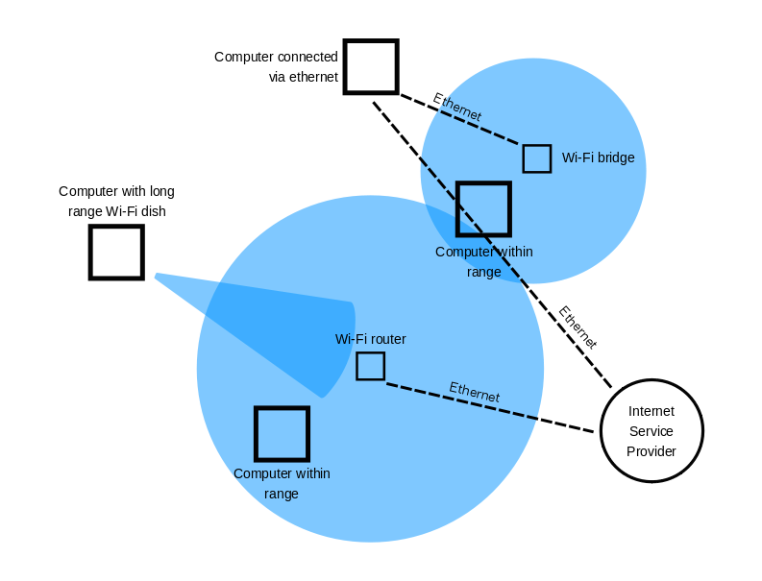
Hotspot
Appropriate parking information transferred
to web application through a Wi-Fi Hotspot
activated in the parking area
* https://en.wikipedia.org/wiki/Hotspot_(Wi-Fi)

Slide 20
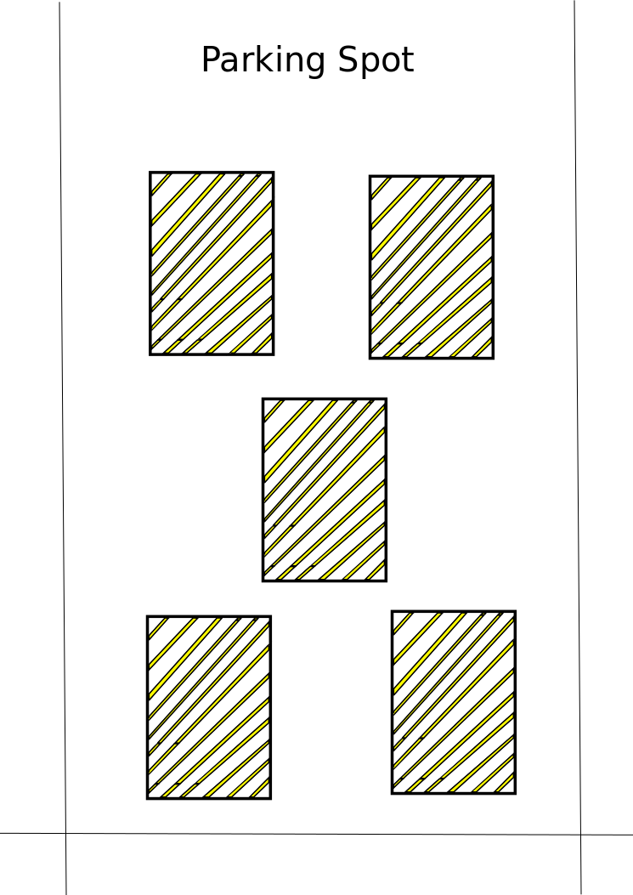
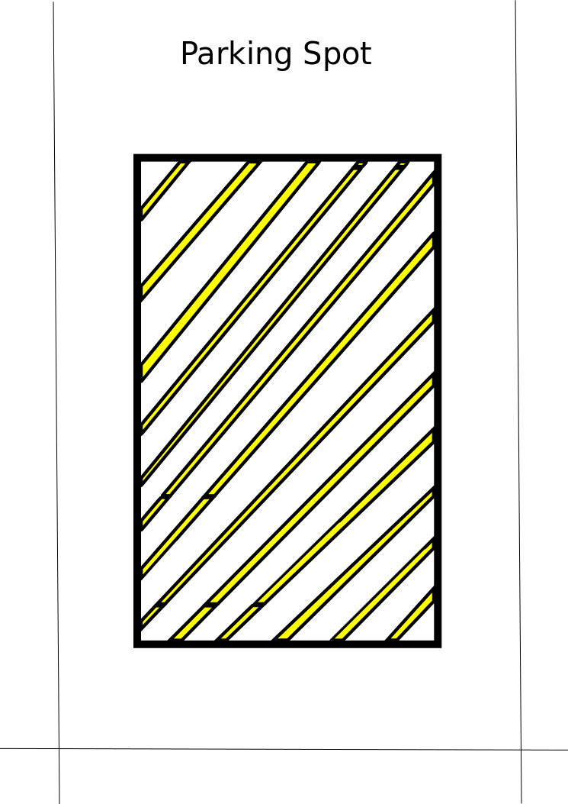
Progress - Technical
Achievement
Pattern Recognition
Detection of free parking spaces from provided image sample

Slide 21
Back End
Ideal Test Subject

Slide 22
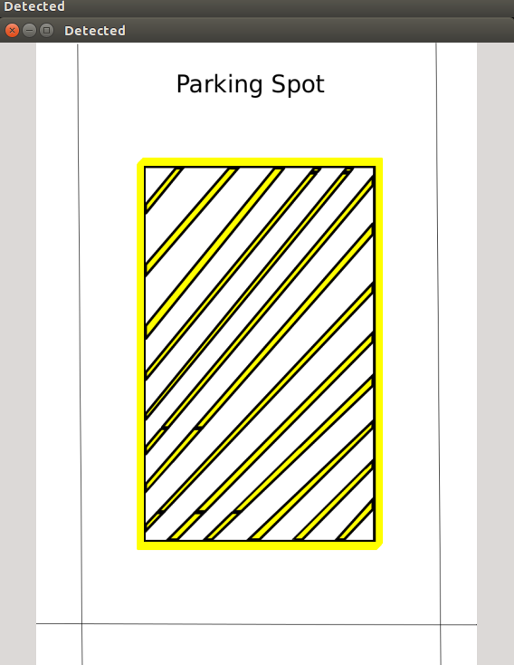
Progress
Single pattern matching

Slide 23
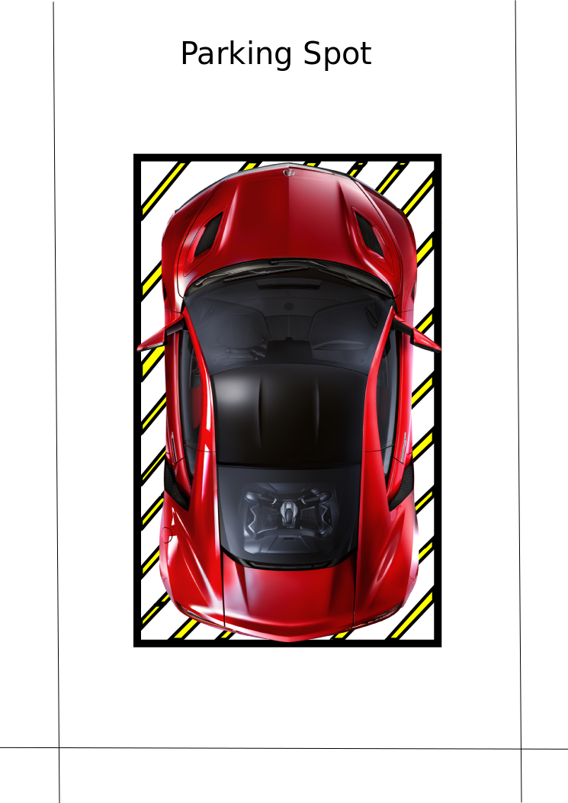
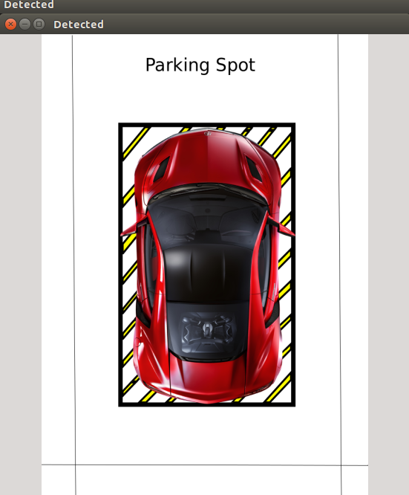
Progress
Single Pattern Occupied

Slide 24
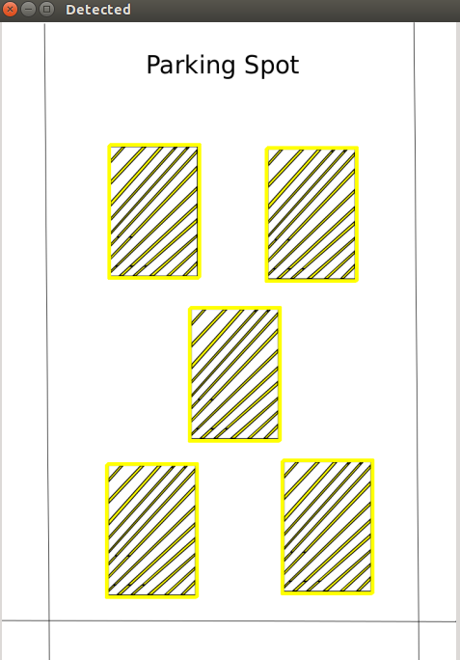
Progress
Empty Parking Space (Multiple)

Slide 25
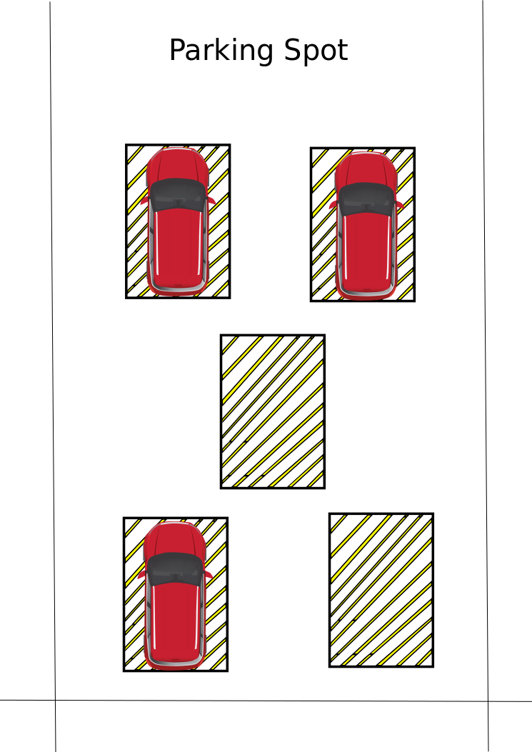
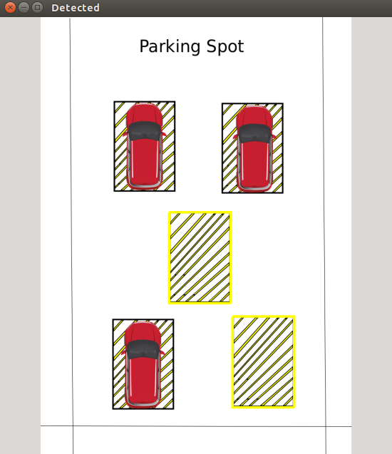
Progress
Occupied Parking
Space

Slide 26
Back End
Real Test Subject

Slide 27
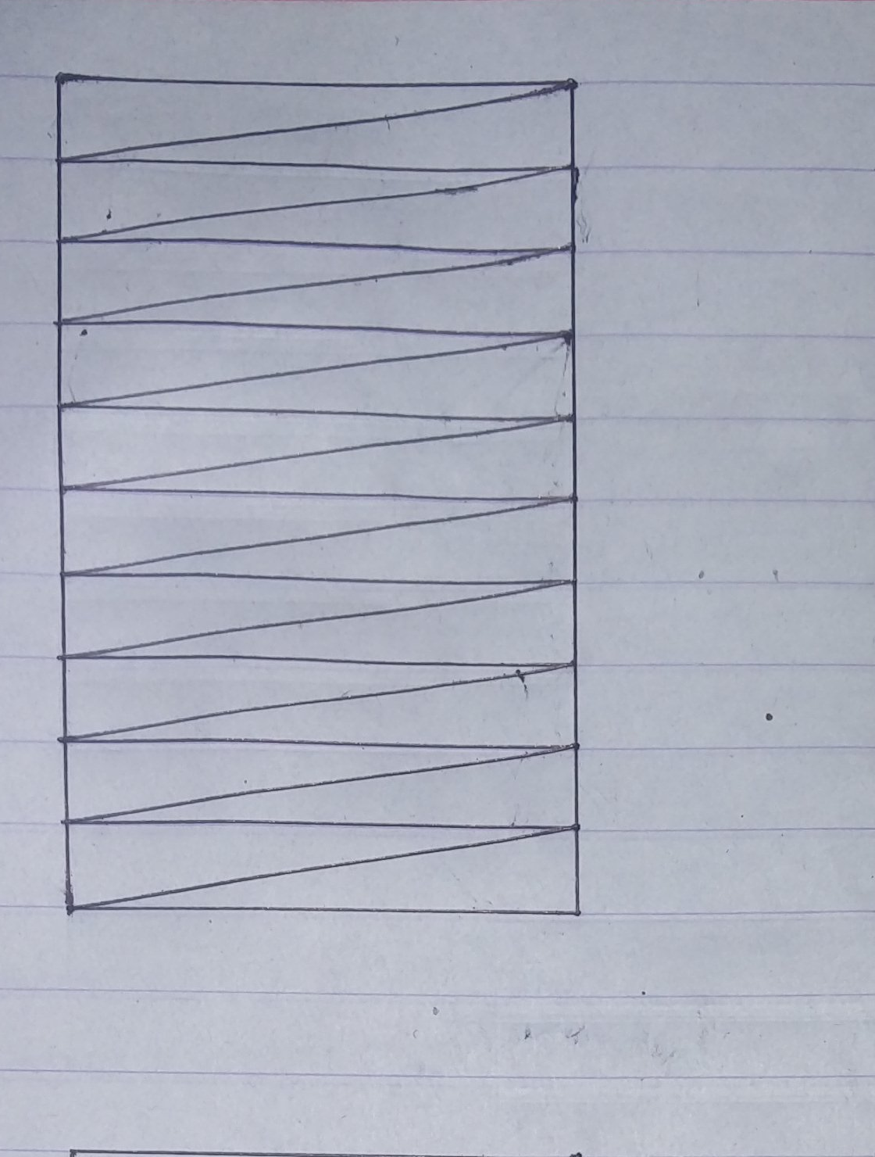
Progress - Real Implementations
Open Parking Space

Slide 28
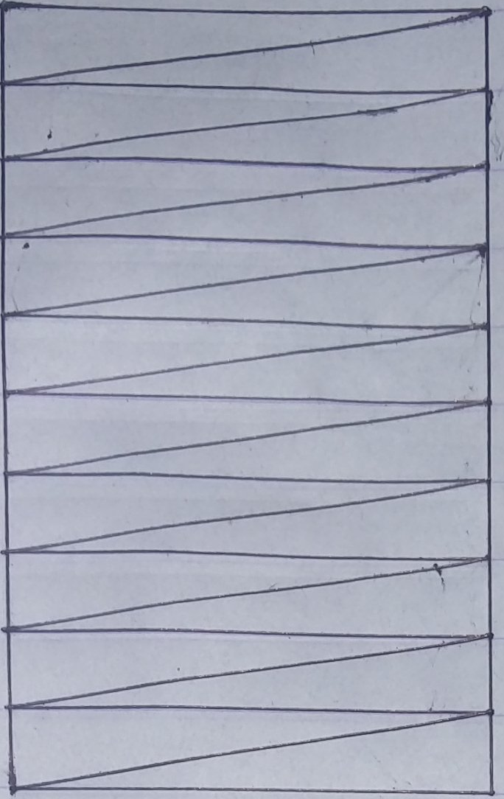
Matching pattern template

Slide 29
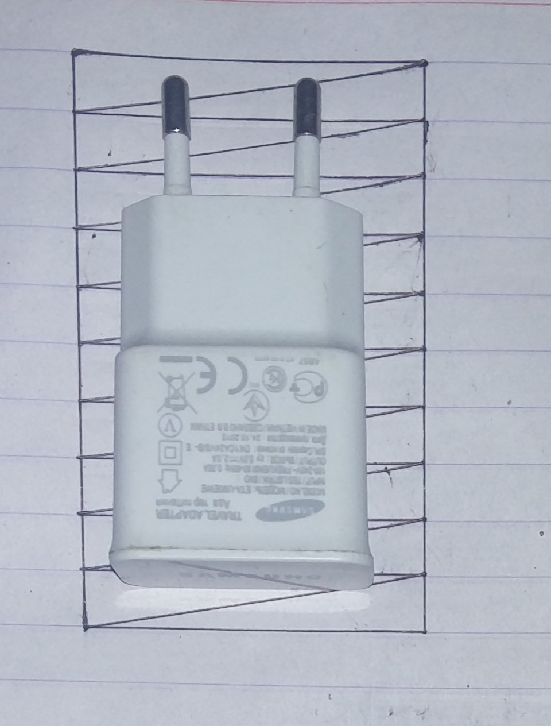
Occupied Parking Space

Slide 30
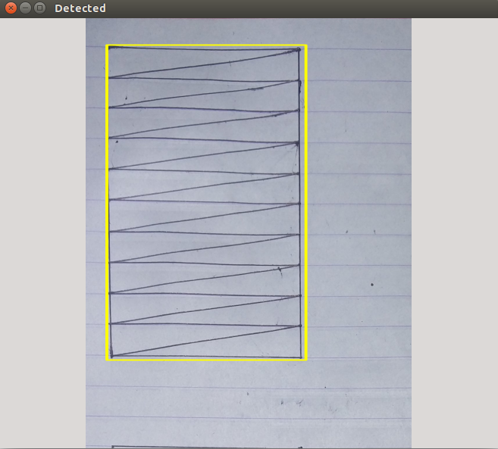
Output
Open Space
Detection

Slide 31
Creation of webpage
Back-end development Phase -I
Status - Completed
Further improvements and addition of extra features
Product Prototype
14.08.16
21.0816
25.08.16
28.08.16
01.09.16
Backend development Phase II
Integration of frontend and backend Status - Pending
Testing and Debugging

Slide 32
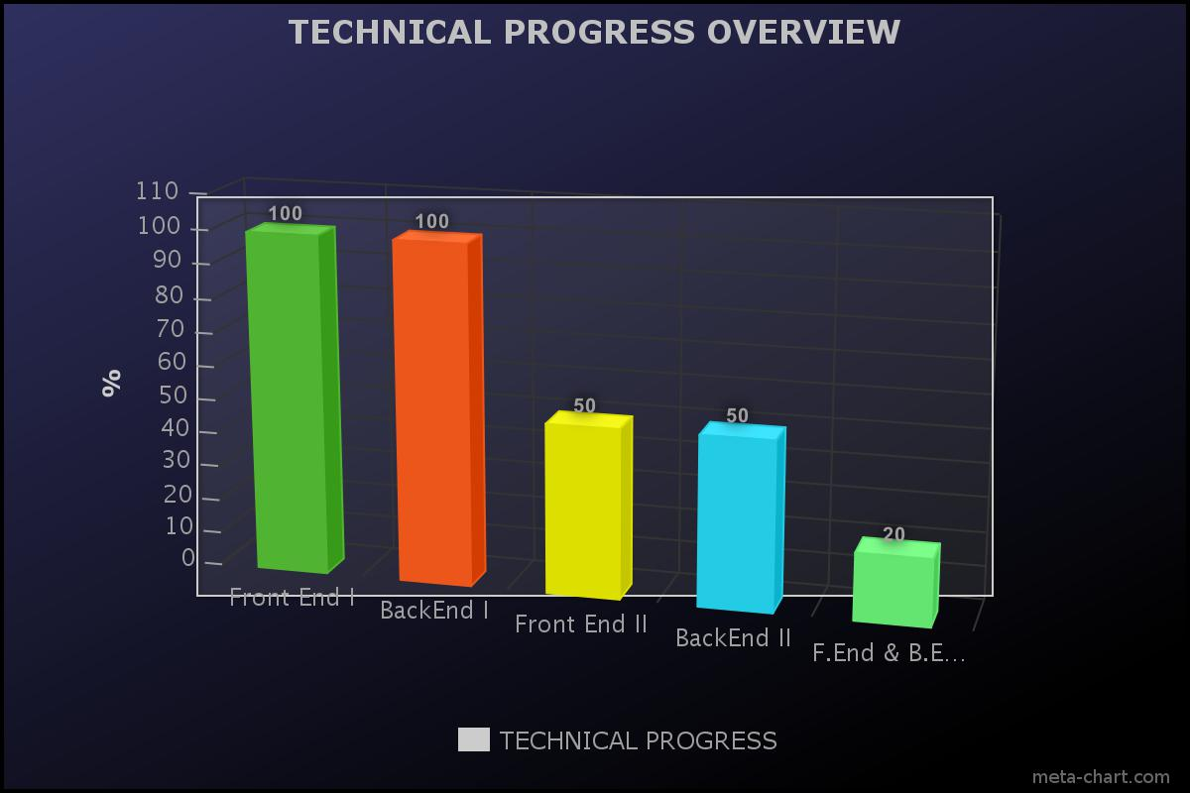

Slide 33


